Slide 1
Protecting Lunar Legacy Sites during THE Google Lunar XPRIZE
Derek Webber
(Former Vice Chair of GLXP International Judging Panel)
UN Vienna UNCOPUOS June 17th 2019

Slide 2
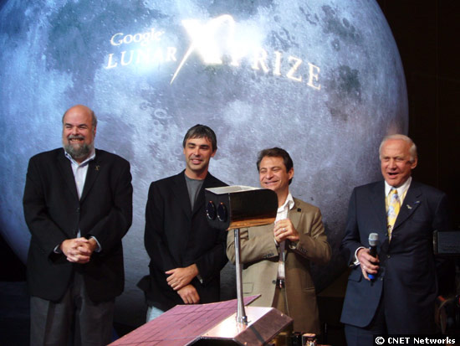
Google Lunar XPRIZE Competition opened 2007
Prize PURSE of $30M – Low cost return to Moon

Slide 3
THE GLXP REQUIREMENTS
Open to world-wide competition
Privately, not government, financed
Prize purse offered by Google of $30M
Object was to land robotically on the Moon, move 500m, and transmit back images
Extra Heritage Prize bonus (up to $4M) for images of any and all previous mission sites
Judging panel of nine independent international judges appointed

Slide 4
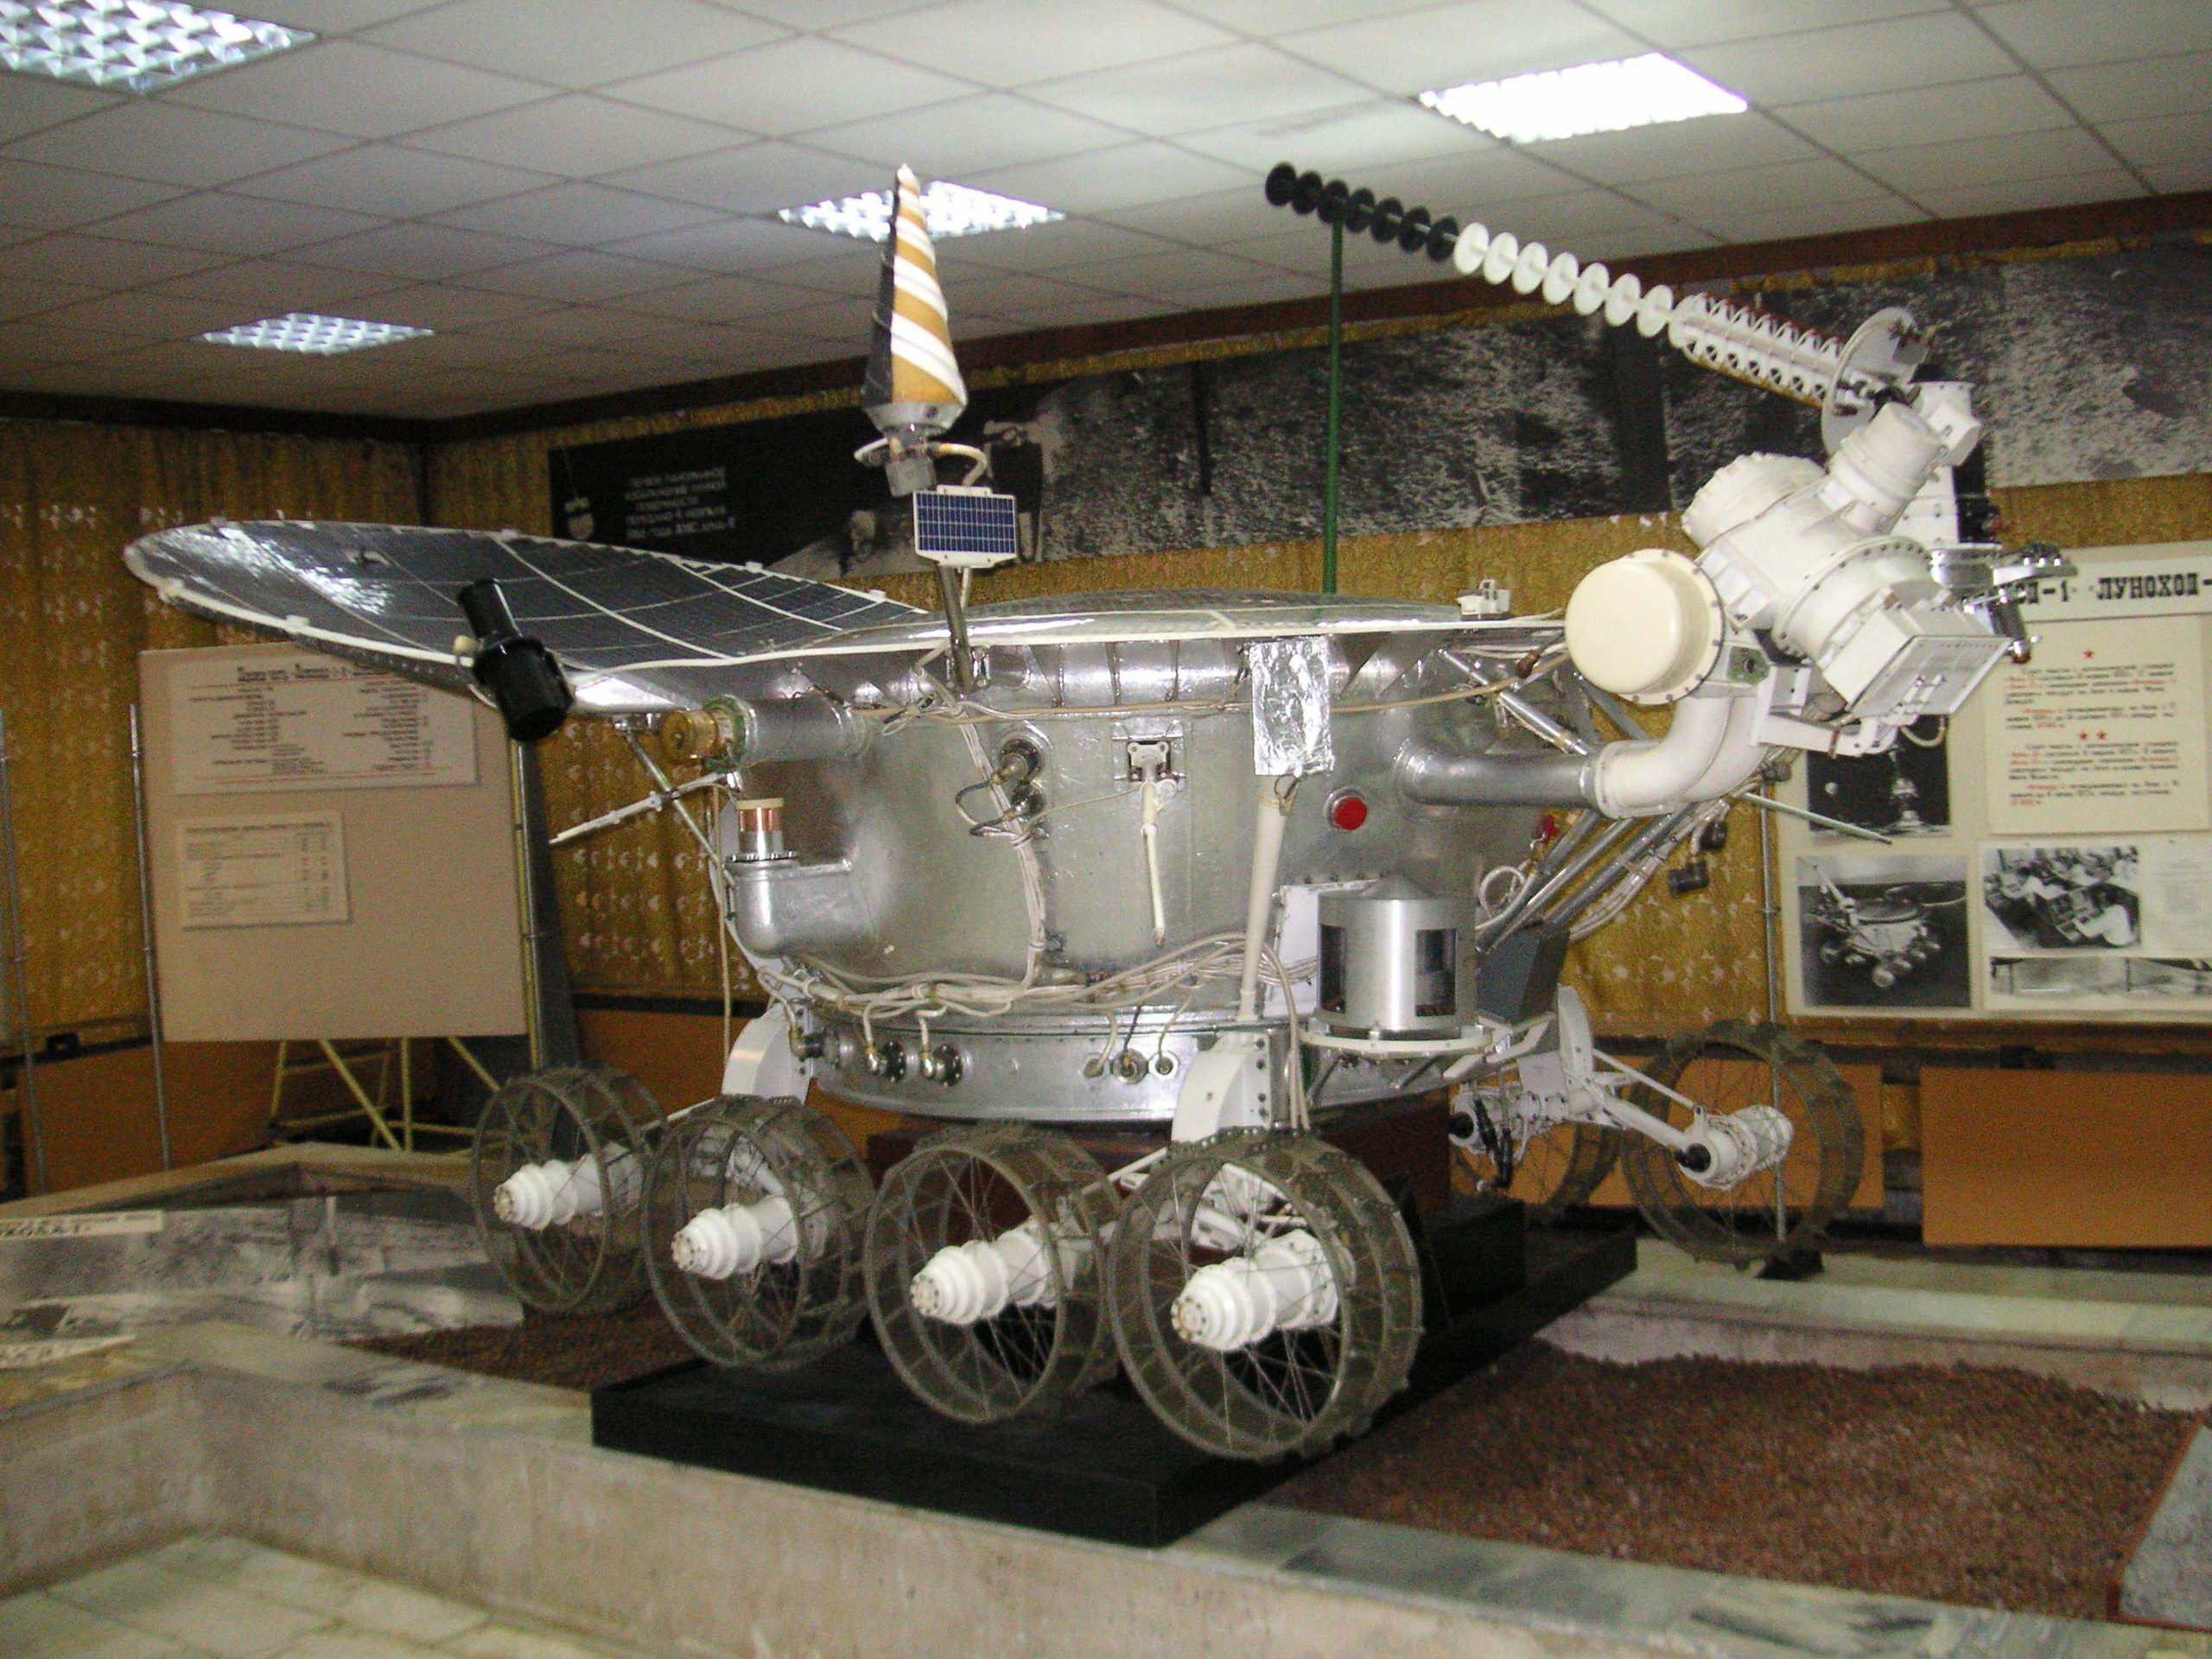
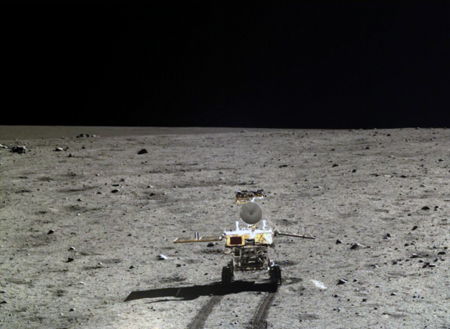
Potential GLXP target HERITAGE sites could include Lunokhod, Hutu, APOLLO, etc

Slide 5
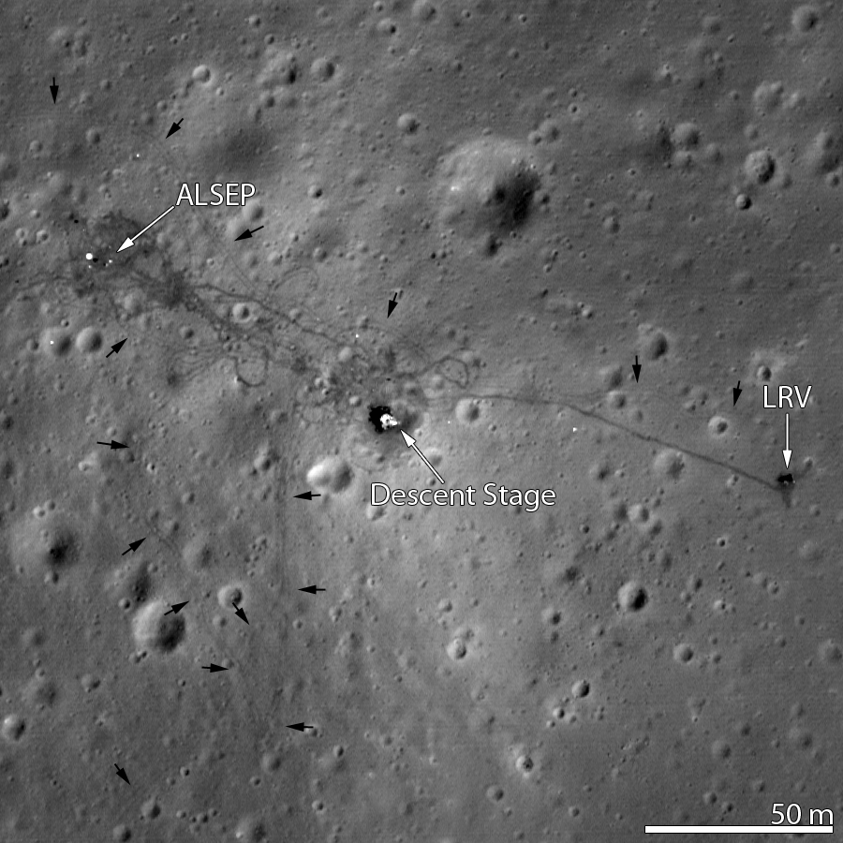
HERITAGE SITE tracks ARE still visible ON THE MOON today….
( For Example Apollo 15 site)

Slide 6
THE GAP EXPOSED – SOME UNFINISHED REGULATORY/ TREATY BUSINESS….
There was a GLXP prize incentive to visit Heritage Sites and send back good photos
The prizes covered all potential lunar sites of all countries that have performed lunar landings
There was a risk of damage to the sites (hardware and tracks, etc) from the different kinds of visiting GLXP spacecraft – Landers, Rovers, Hoppers
There were no national or international regulatory protections for the sites

Slide 7
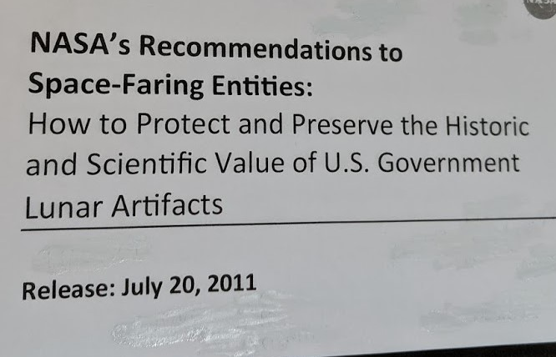
NASA and Smithsonian Museum produced Suggested Partial guidelines…….
Protection from landers, rovers and hoppers
93 pages of proposals
Based on best available data on disturbance from jet efflux, etc.
No legal basis or requirement

Slide 8
SUMMARY OF THE NASA/NASM GUIDELINES….
There are specific suggestions for landers, rovers and hoppers
There are guidelines for both successful missions and various failure scenarios
Recommendations attempt to mitigate dust contamination during both landing and mobility phases of mission
Exclusion boundaries are proposed, as well as low level overflight restrictions, and limitations on rover wheel speed near to Heritage Sites.
Recommendations also include “planetary protection” elements regarding residual propellants, etc

Slide 9
What did the GLXP Judges do?
GLXP was probably the first threat to this 50 year heritage.
The NASA/NASM Guidelines document of July 2011 was adopted by the GLXP Judges as a good basis, suggesting exclusion zones and other protocols, and was therefore put into the rules of the competition
Teams had to submit Mission Plans, subject to judges approval, which addressed the way that the Heritage Sites would be protected, following the NASA/NASM guidelines
Teams were required to present to the judges test and/or simulation data on the approach path, landing accuracy, mobility path on surface, distance measurement and error, planned wheel speed for rovers, flypath path for hoppers, and contamination prevention protocols

Slide 10
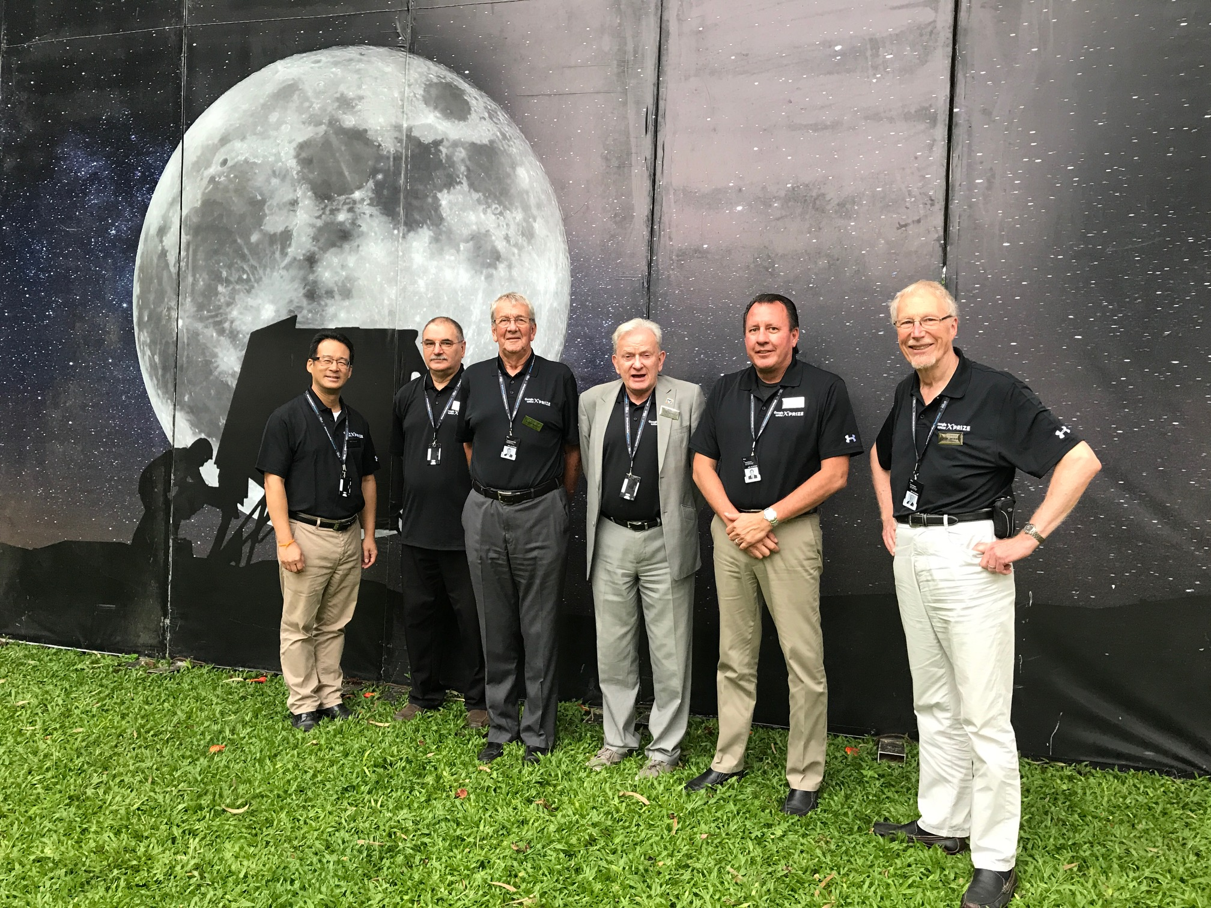
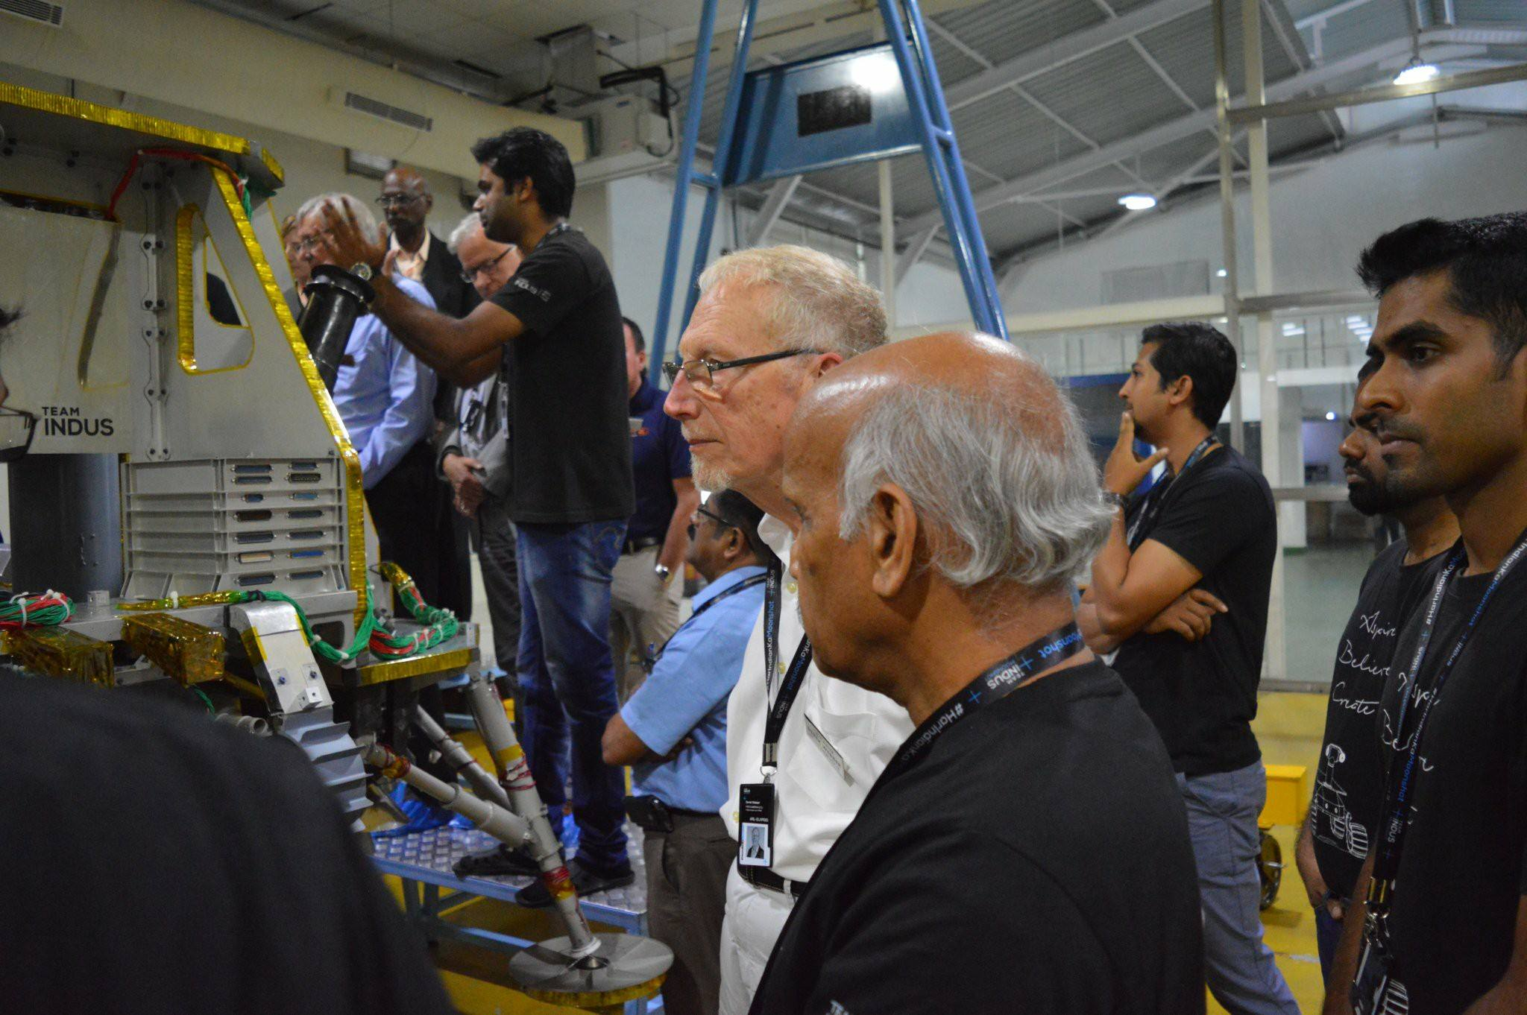
Visiting Indian GLXP Team To Monitor Mission PLAN TESTs……
GLXP Judges in Bangalore, India, Oct 2017
Judges monitoring Team Indus lander

Slide 11

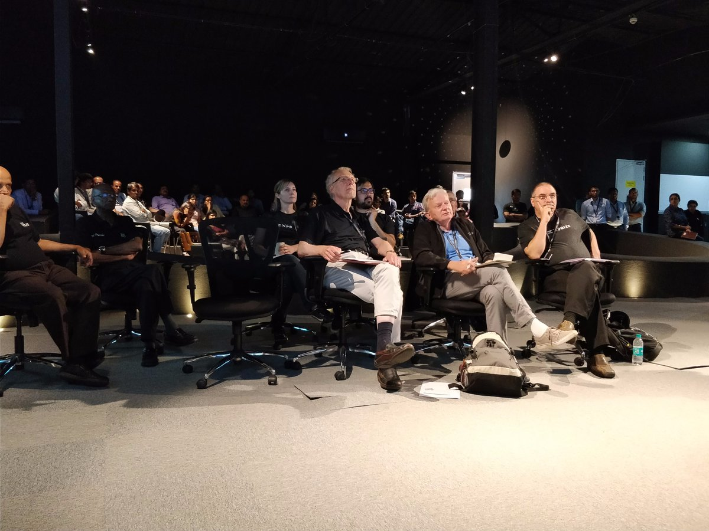
Judging process in the Team Indus control room
Control Room facility for Team Indus in Bangalore, India
GLXP Judges monitor tests during Mission Plan Review in Oct 2017

Slide 12
HOW did the GLXP WORK OUT?
Two Teams (Team Indus from India and Team Hakuto from Japan) had both conducted Mission Plan Reviews in front of the Judges before the end of the competition in March 2018.
They each satisfied the judges regarding their Heritage Site protection plans
However, the competition ended before they were able to launch.
The process that was followed to that point however did ensure that the Heritage Site protections were in place, and the GLXP judges were able to act as a kind of watchdog for this activity.
The judges panel was disbanded when the GLXP competition ended, and so currently there is no “watchdog”.
And some former GLXP teams are still progressing to launch for the Moon, even without prize incentives. An example was the Israeli Team SPACEIL with their Beresheet lander.

Slide 13
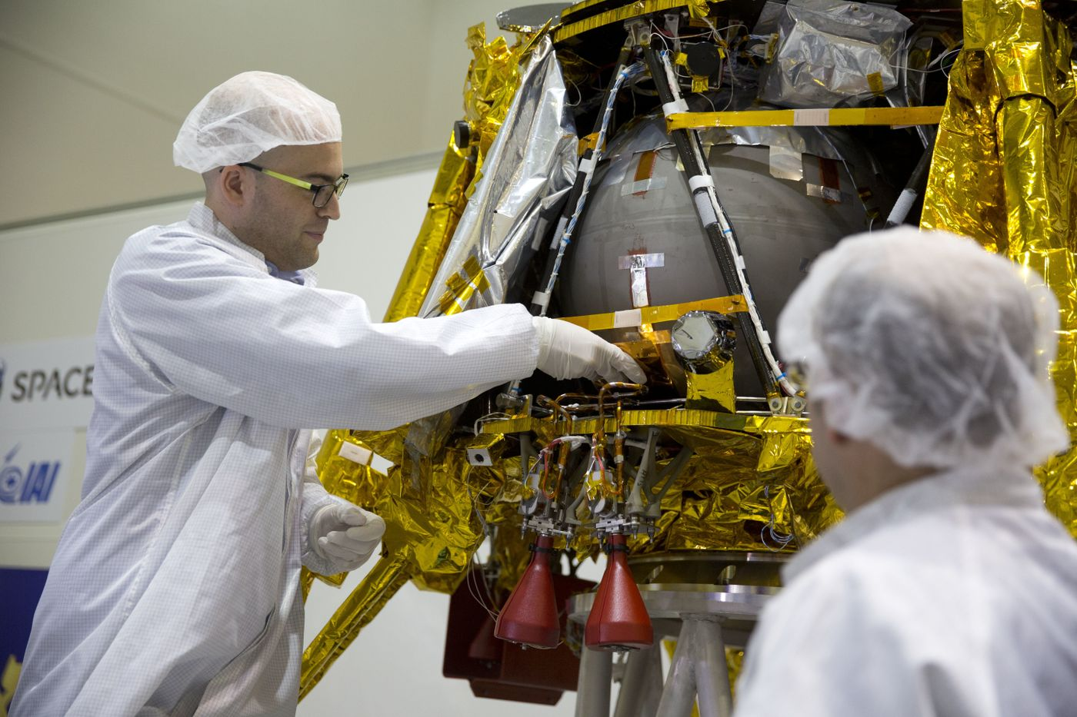

SpaceIL Team shoots for Moon in 2019….
Final adjustments to the Beresheet Lander, Feb 2019
The Beresheet lander sends back image of Moon, April 2019

Slide 14
So what haPpens now?
Former GLXP team SpaceIL has already “hard-landed” on the Moon, and will try again.
Other former GLXP Teams are continuing, in various countries, as are various commercial entrepreneurial endeavors. NASA has just awarded $79M to former GLXP team Astrobotic, $97M to OrbitBeyond (using the former GLXP team Indus lander spacecraft), and $77M to another company (Intuitive Machines) to launch Moon landers by mid 2021
Various governments also have plans for future Moon landings
The GLXP Judging panel is disbanded and so there is now no “watchdog” in place. We independent international judges did what we could, during the GLXP competition.
FORALLMOONKIND is seeking a remedy for this situation, which will need to be international.
The NASA/NASM Guidelines are a helpful start, but need to reflect an international consensus about the steps needed, and to be updated to take account of the latest engineering data.

Slide 15
Thank YOu
Derek Webber, Damariscotta, Maine, USA
Dwspace@aol.com

